Slide 1
Linked List

Slide 2
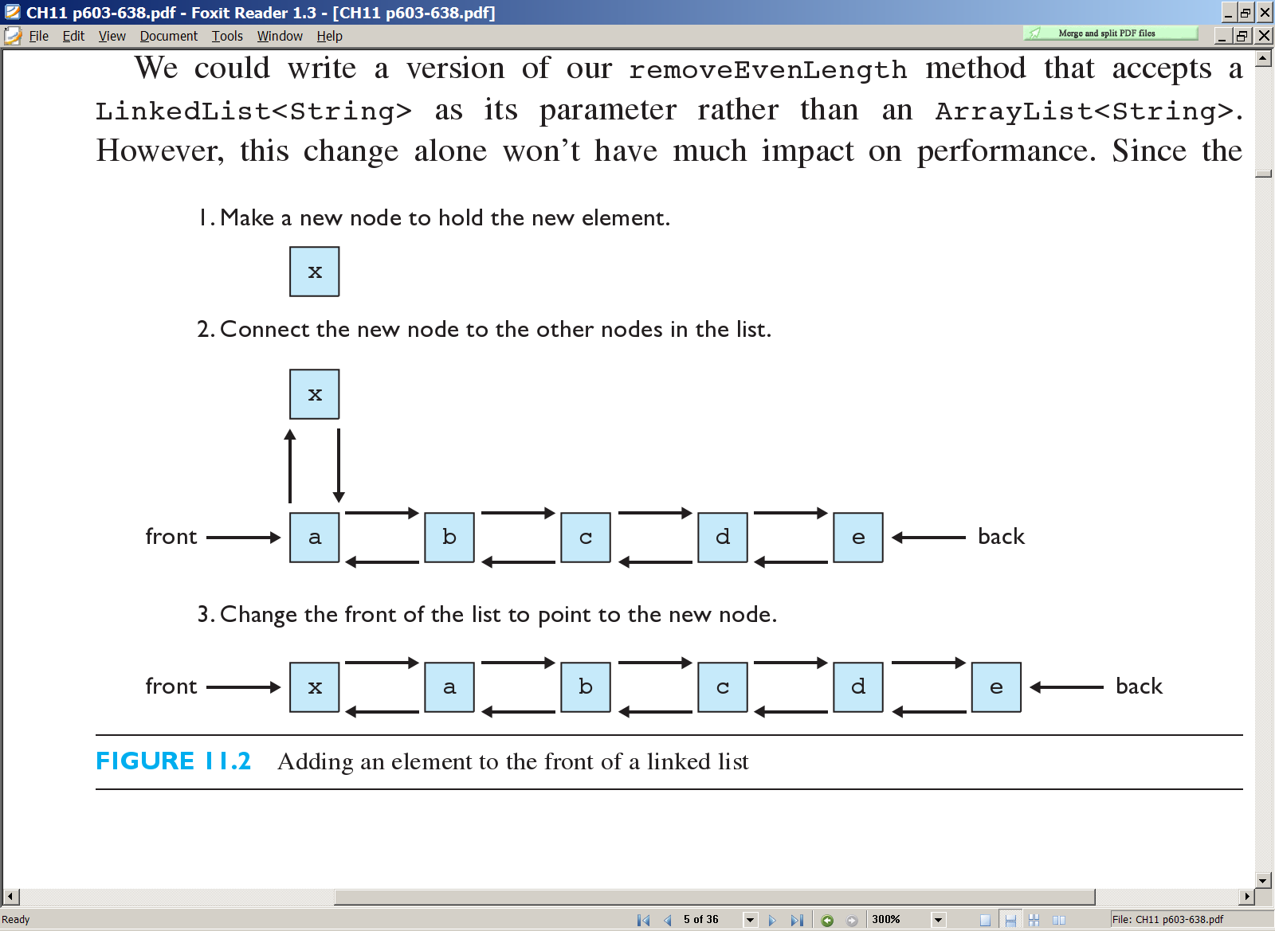
Linked list
linked list: a list implemented using a linked sequence of values
  each value is stored in a small object called a node, which also contains references to its neighbor nodes
  the list keeps a reference to the first and/or last node
  in Java, represented by the class LinkedList

Slide 3
Nodes and Linked Lists
  A linked list is a list that can grow and shrink while
  the program is running
  A linked list is constructed using pointers
  A linked list often consists of structures or classes that contain a pointer variable connecting them to other dynamic variables
  A linked list can be visualized as items, drawn as
  boxes, connected to other items by arrows
head
10
12
14 | end

Slide 4
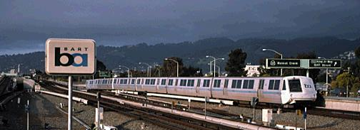
Linked Lists vs Arrays
Think of an Array like the mailboxes in an apartment building—a series of identical boxes identified by a number
Think of Linked Lists like a train—a series of box cars each one hooked up to the next

Slide 5
Linked Lists vs Arrays
When you create an array it has a fixed size. You cannot add or remove "mail boxes"
A Linked List is more flexible. Just like a train, you can add or remove as many "box cars" as you want, anywhere in the train

Slide 6
Linked Lists vs Arrays
Arrays are fast and easy to access—if you know the index of the "mail box" you want, you can immediately access it.
Finding a particular "box car" in a linked list isn't as easy. You have to board the first "box car" in the list, and go through them in order to find the one you are looking for.

Slide 7
Arrays
Consider limitations of Java arrays
  Array length is not dynamically changeable
  Possible to create a new, larger array and copy elements – but this is awkward, contrived
  or
  Inserting an item inside the array requires shifting.
More elegant solution is use instance of Linked List
  Length is changeable at run time

Slide 8
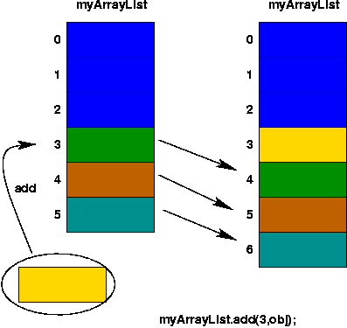
Inserting element need shifting……

Slide 9
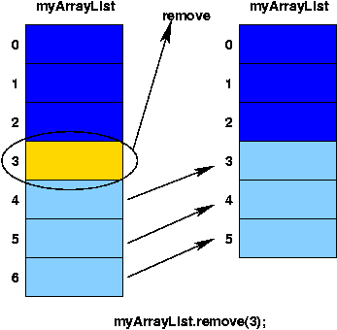
Remove element need shifting…….

Slide 10
Nodes
The boxes in the previous drawing represent the nodes of a linked list
  Nodes contain the data item(s) and a pointer that can point to another node of the same type
  The pointers point to the entire node, not an individual item that might be in the node
The arrows in the drawing represent pointers
first
A0
A1
A2
A3

Slide 11
The first node is called the head
The pointer variable head, points to the first node
  The pointer named head is not the head of the list…it
  points to the head of the list
The last node contains a pointer set to NULL

Slide 12
An Empty List
A list with nothing in it is called an empty list
An empty linked list has no head node
The head pointer of an empty list is NULL
head = NULL;
  Any functions written to manipulate a linked list
  should check to see if it works on the empty list

Slide 13
List features
Maintains elements in the order they were added.
(new elements are added to the end by default)
Duplicates are allowed.
The list manages its own size; the user of the list does not need to worry about overfilling it.

Slide 14
Operations of Node
  add element to end of list
  insert element at given index
  clear all elements
  search for element
  get element at given index
  remove element at given index
  get size

Slide 15
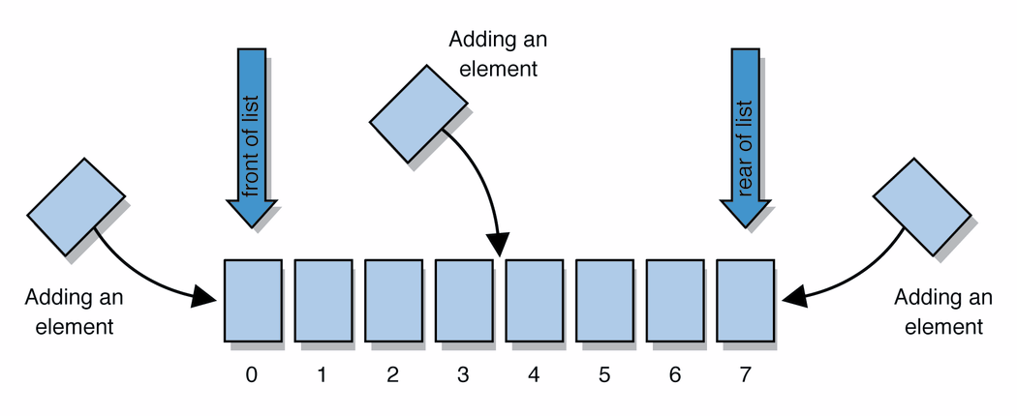

Slide 16
Singly Linked List
If a node has a link only to its successor in this sequence, the list is called a singly linked list.
Note that only one variable p is used to access any node in the list.
The last node on the list can be recognized by the null reference field.

Slide 18
tail

Slide 19
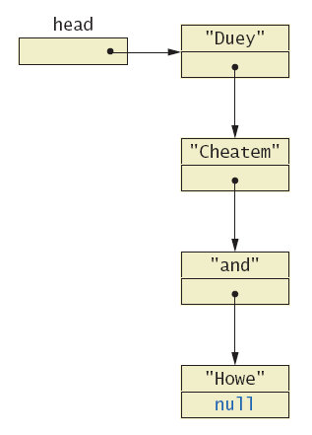

Slide 20
Insertion of an Element at the Head

Slide 23
Insertion of an Element at the Tail

Slide 25
Linked List: Insertion
a
b
c
d
current
Insert X immediately after current position
a
b
c
d
current
x

Slide 26
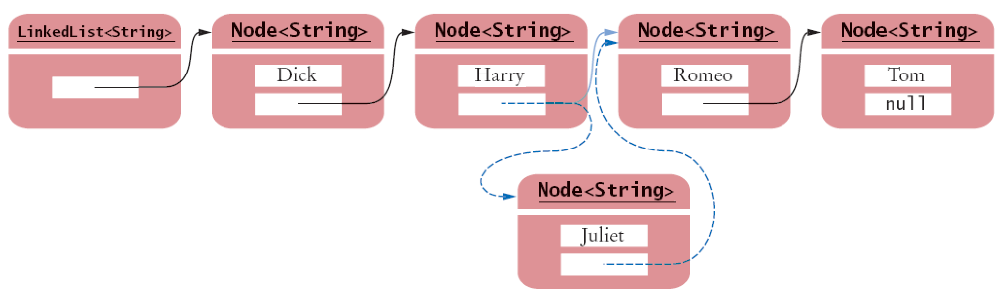

Slide 27
Inserting……..
node
2.5
numerals
one
two
three
Find the node you want to insert after
First, copy the link from the node that's already in the list
Then, change the link in the node that's already in the list

Slide 28
Implementing Insertion
Insertion immediately after current position
  // create a new node
  tmp = new ListNode<DataType>();
a
b
current
tmp

Slide 29
Implementing Insertion
Insertion immediately after current position
  // create a new node
  tmp = new ListNode<DataType>();
  // place x in the element field
  tmp.data = x;
a
b
current
x
tmp

Slide 30
Implementing Insertion
Insertion immediately after current position
  // create a new node
  tmp = new ListNode<DataType>();
  // place x in the element field
  tmp.data = x;
  // x’s next node is b
  tmp.next = current.next;
a
b
current
x
tmp

Slide 31
Implementing Insertion
Insertion immediately after current position
  // create a new node
  tmp = new ListNode<DataType>();
  // place x in the element field
  tmp.data = x;
  // x’s next node is b
  tmp.next = current.next;
  // a’s next node is x
  current.next = tmp;
a
b
current
x
tmp

Slide 32
Implementing Basic Deletion
Delete an item immediately after current position
Basic deletion is a bypass in the linked list.
a
x
b
current
a
b
current

Slide 33
Implementing Basic Deletion
Need a reference to node prior to the one to be deleted.
  current.next = current.next.next;
a
x
b
current
a
x
b
current
a
b
current

Slide 34
Deleting an Element at the Head

Slide 37
Deleting an Element at the Tail
Deletion of an element at the tail of a singly linked list takes more effort.
The difficulty is related with the fact that the last node does not have a link to the previous node which will become the new tail of the list.

Slide 39
should be removed

Slide 40
Deleting an element from a SLL
• To delete the first element, change the link in the header
numerals
one
two
three
• To delete some other element, change the link in its predecessor
numerals
one
two
three
• Deleted nodes will eventually be garbage collected

Slide 41
In order to delete a node from a SLL, you have to change the link in its predecessor
This is slightly tricky, because you can’t follow a pointer backwards
Deleting the first node in a list is a special case, because the node’s predecessor is the list header

Slide 42
Singly Linked Lists and Arrays

Slide 43
Iterate Through The Linked List
If items are stored in contiguous array:
  //step through array, outputting each item
  for (int index = 0; index < a.length; index++)
  System.out.println (a[index]);
If items are stored in a linked list:
  // step through list, outputting each item
  for(ListNode p=first; p!=null; p=p.next)
  System.out.println (p.data);
A0
A1
A2
A3
first

Slide 44
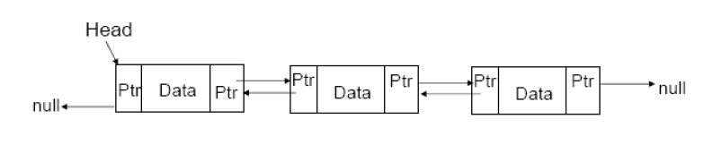
Doubly Linked List
Each node has a reference or pointer back to the previous nodes.
A list element contains the data plus pointers to the next and previous list items as shown in the picture below.

Slide 45
If we wish to traverse a list both forwards and backwards efficiently,
Or
If we wish, given a list element, to determine the preceding
and
Following elements quickly
then the doubly-linked list comes in handy.

Slide 46
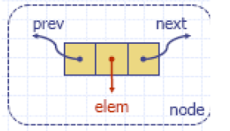
Nodes implement Position and store:
– element
– link to the previous node
– link to the next node

Slide 47
Adding a new node at the END
To add a node to a list, the node has to be created, its fields properly initialized, and then the node needs to be incorporated into the list.

Slide 48
The process of Inserting a node at the end of a doubly linked list is performed in six steps:
A new node is created, and then its four fields are initialize as examples info, el, next and prev.

Slide 49
2. the info field to the number el being inserted
3. the next field to null
4. and the prev field to the value of tail so that this field points to the last node in the list.
But now, the new node should become the last node

Slide 50
5. tail is set to reference the new node. But the new node is not yet accessible from its predecessor; to rectify this,
6. the next field of the predecessor is set to reference the new node.

Slide 51
A special case concerns the last step. It is assumed in this step that the newly created node has a predecessor, so it accesses its prev field.
It should be obvious that for an empty linked list, the new node is the only node in the list and it has no predecessor.

Slide 52
class ListManager
{
private Node head;
private int length;
private int currentDataValue = 10;
}

Slide 53
public void addToEnd ()
{
Node anotherNode = new Node (currentDataValue);
Node temp;
if (isEmpty() == true)
head = anotherNode;
else
{
temp = head;

Slide 54
while (temp.next != null)
{
temp = temp.next;
}
temp.next = anotherNode;
anotherNode.previous = temp;
}
currentDataValue += 10;
length++;
}

Slide 55
Adding a new Node at the FRONT

Slide 56
DLL:- Adding anywhere
public void addToPosition (int position)
{
Node anotherNode = new Node(currentDataValue);
Node temp;
Node prior;
Node after;
int index;

Slide 57
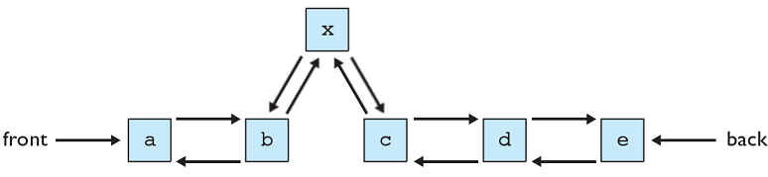

Slide 58
if ((position < 1) || (position > (length+1)))
{
System.out.println("Position must be a value between 1-" + (length+1));
}

Slide 59
else
{ // List is empty
if (head == null)
{ if (position == 1)
{ currentDataValue += 10;
length++;
head = anotherNode;
}
else
System.out.println("List empty, unable to add node to " +"position " + position);
}

Slide 60
// List is not empty, inserting into first position.
else if (position == 1)
{
head.previous = anotherNode;
anotherNode.next = head;
head = anotherNode;
currentDataValue += 10;
length++;
}

Slide 61
/* List is not empty inserting into a position other than the first */
else
{
prior = head;
index = 1;
/* Traverse list until current is referring to the node in front of the position that we wish to insert the new node into. */

Slide 62
while (index < (position-1))
{ prior = prior.next;
index++;
}
after = prior.next;
/* Set the references to the node before the node to be inserted. */
prior.next = anotherNode;
anotherNode.previous = prior;

Slide 63
/* Set the references to the node after the node to be inserted. */
if (after != null)
after.previous = anotherNode;
anotherNode.next = after;
currentDataValue += 10;
length++;
} } }

Slide 64
Deleting the LAST NODE from the DDL
Deleting the last node from the doubly linked list is straight forward because there is direct access from the last node to its predecessor, and no loop is needed to remove the last node.

Slide 65
When deleting a node from the list, the temporary variable el is set to the value in the last node,
then tail is set to its predecessor,
and
the last node is cut off from the list by setting the next field of the next to last node to null.

Slide 66
In this way, the next to last node becomes the last node, and the formerly last node is abandoned.
The last step is returning the value stored in the removed node.

Slide 67
An attempt to delete a node from an empty list may result in a program crash.
Therefore, the user has to check whether the list is not empty before attempting to delete the last node.

Slide 68
public void delete (int key)
{
int indexToDelete;
int indexTemp;
Node previous;
Node toBeDeleted;
Node after;
indexToDelete = search(key);

Slide 69
// No match, nothing to delete.
if (indexToDelete == -1)
{
System.out.println("Cannot delete element with a data value of “ + key + " because it was not found.");
}

Slide 70
else
{
// Deleting first element.
if (indexToDelete == 1)
{
head = head.next;
length--;
}

Slide 71
else
{
previous = null;
toBeDeleted = head;
indexTemp = 1;
while (indexTemp < indexToDelete)
{
previous = toBeDeleted;
toBeDeleted = toBeDeleted.next;
indexTemp++;
}

Slide 72
previous.next = toBeDeleted.next;
after = toBeDeleted.next;
after.previous = previous;
length--;
: : :

Slide 73
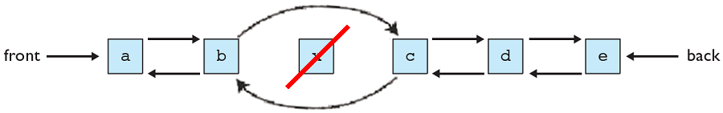
Deleting a node from a DLL
Before we can remove a node, we have to find it
We traverse the list, moving from one node to the next until we find the one we want to delete
Then we rearrange the handles to "skip over" the target node

Slide 74
Deleting a node from a DLL
Node deletion from a DLL involves changing two links
myDLL
a
b
c
Deletion of the first node or the last node is a special case
Garbage collection will take care of deleted nodes

Slide 75
Java Implementation of DDL
public class IntDLLNode
{ public int info;
public IntDLLNode next, prev;
public IntDLLNode (int el) {
this (el,null,null); }
public IntDLLNode (int el, IntDLLNode n, IntDLLNode p) {
info = el; next =n; prev=p;
} }

Slide 76
public class IntDLList
{
private IntDLLNode head, tail;
public IntDLList ( )
{ head = tail = null; }
public boolean isEmpty( )
{ return head == null; }
public void addToTail (int el)

Slide 77
{
if (!isEmpty ( ))
{
tail = new IntDLLNode (el, null, tail);
tail.prev.next = tail; }
else head = tail = new IntDLLNode(el);
}

Slide 78
public int removeFromTail ( )
{
int el = tail.info;
if (head == tail) // if only one node in the list;
head = tail =null;
else { // if more than one node in the list;
tail = tail.prev;
tail.next = null; }
return el;
}

Slide 79
Illustration of a linked list in memory
node
pointer to a
next node
pointer to
an element

Slide 80
node
pointer to a
next node
pointer to
an element

Slide 81
node
pointer to a
next node
pointer to
an element

Slide 82
node
pointer to a
next node
pointer to
an element

Slide 84
DLLs compared to SLLs
Advantages:
  Can be traversed in either direction (may be essential for some programs)
  Some operations, such as deletion and inserting before a node, become easier
Disadvantages:
  Requires more space
  List manipulations are slower (because more links must be changed)
  Greater chance of having bugs (because more links must be manipulated)

Slide 85
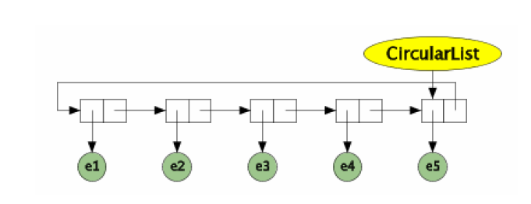
Circular List

Slide 86
Circular-linked lists: Last node's next references the first node. Works with or without headers.
prev
A
B
C
next
first

Slide 87
A circular list is needed in which nodes form a ring: The list is finite and each node has a successor.
In an implementation of a circular singly linked list, we can use only one permanent reference, tail, to the list even though operations on the list require access to the tail and its successor, the head.
To that end, a linear singly linked list uses two permanent references, head and tail.

Slide 88
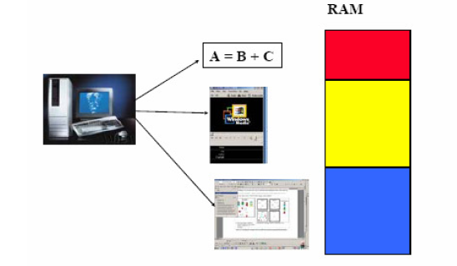
Uses of a Circular List
e.g., Memory management by operating systems

Slide 89
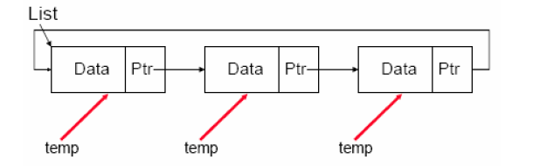
Searches With A Circular Linked Lists
Cannot use a null reference as the signal that the end of the list has been reached.
Must use the list reference as a point reference (stopping point) instead.

Slide 90
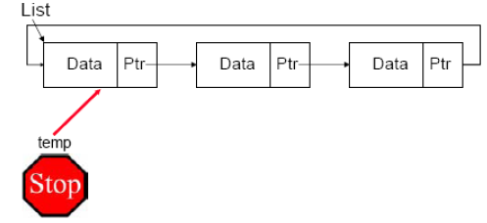
Traversing A Circular Linked List
Cannot use a null reference as the signal that the end of the list has been reached.
Must use the list reference as a point reference (stopping point) instead.

Slide 91
Java Implementation
public void display ()
{
Node temp = list;
System.out.println("Displaying list");
if (isEmpty() == true)
{
System.out.println("Nothing to display, list is empty.");
}

Slide 92
do
{
System.out.println(temp.data);
temp = temp.next;
} while (temp != list);
System.out.println();
}

Slide 93
Other operations on linked lists
Most “algorithms” on linked lists—such as insertion, deletion, and searching—are pretty obvious; you just need to be careful
Sorting a linked list is just messy, since you can’t directly access the n^{th} element—you have to count your way through a lot of other elements.

Slide 94
Linked lists have some serious drawbacks:
– They require sequential scanning to locate a searched-for element.
– The search starts from the beginning of the list and stops when either a searched-for element is found or the end of the list is reached without finding this element.
– Ordering elements on the list can speed up searching, but a sequential search is still required.

Slide 95
Therefore, we may think about lists that allow for skipping certain nodes to avoid sequential processing.
A skip list is an interesting variant of the ordered linked list that makes such a non sequential search possible.

Slide 96
Skip List
A node in a Skip List contains an array of pointers.
The size of this array is chosen at random (between 0 and some MAX_LEVEL) at the time when the node is created.
The size of this array determines the level of the node. For example, a level 3 node has 4 forward pointers, indexed from 0 to 3.

Slide 97
Each node in a skip list has an array of several 'forward pointers' that link to nodes further along in the list.
The number of forward pointers (node height) in a particular node is determined by a probability function that is applied during insertion, and that serves to create a few 'tall' nodes, more 'medium size' nodes and lots of 'small' nodes.

Slide 98
In a skip list of n nodes, for each k and i such that 1 <= k <= [log n] and
1 <= i <= [n/2^{k-1}] - 1, the node in position
2^{k-1} * i points to the node in position
2^{k-1} * (i + 1).
The distribution of the node heights is random.

Slide 99
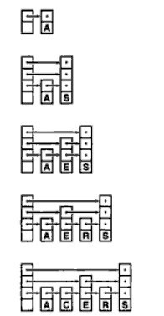
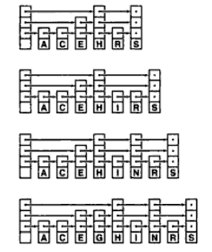

Slide 100

The number of reference fields indicates the level of each node, and the number of levels is maxLevel = [lg n] + 1.

Slide 101
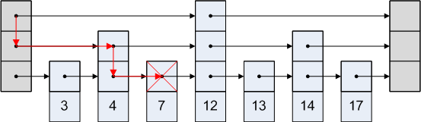
Search for value 8 would proceed like this:
Since we landed on a 7, but we were looking for an 8, that means that 8 is not in the set.

Slide 102
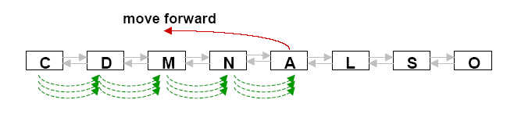
Self – Organizing List
The introduction of skip lists was motivated by the need to speed up the searching process.
Self-Organizing lists in which the order of elements changes based on searches which are done.

Slide 103
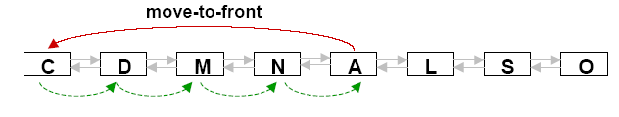
There are many different ways to organize the lists, and this section describes four of them:
– Move-to-front method. After the desired element is located, put it at the beginning of the list.
Examples– important tel. numbers placed near the front of tel. directory

Slide 104
– Transpose method. Any node searched is swapped with the preceding node
– Count method. Each node (position) counts the number of times it was searched for – nodes are ordered by decreasing count
– Ordering method. Order the list using certain criteria natural for the information under scrutiny.

Slide 105
The ordering method already uses some properties inherent to the information stored in the list.
For example,
if we are storing nodes pertaining to people,
then the list can be organized alphabetically by the name of the person or the city or in ascending or descending order using, say, birthday or salary.

Slide 106
This is particularly advantageous when searching for information that is not in the list, because the search can terminate without scanning the entire list.
The count method can be subsumed in the category of the ordering methods if frequency is part of the information.

Slide 107
With this ordering, all the data are already ordered by the frequency of their occurrence in the body of data so that the list is used only for searching, not for inserting new items.
Therefore, this approach requires two passes through the body of data,
– one to build the list
– another to use the list for search alone.

